Slide 1



Course Title
What’s my Store Worth?
presented by
Alan M. Friedman, CPA & Daniel Jobe
Friedman, Kannenberg & Company, P.C.

Slide 2
Objectives
Valuation fundamentals & methodologies
Identify the “difficulties” and “quirky issues” in valuing music stores
Items that “Do” and “Don’t” add value
Teach you how to compute the value of your store (or a potential acquisition store)
Succession transition tips / Q&A along the way

Slide 3
This session is for you if…
You want to know how much your store is worth
You want to transition your store to someone you know (your kids, key employees, etc.)
You want to sell your store
You want to buy a store
You want to attract an investor

Slide 4
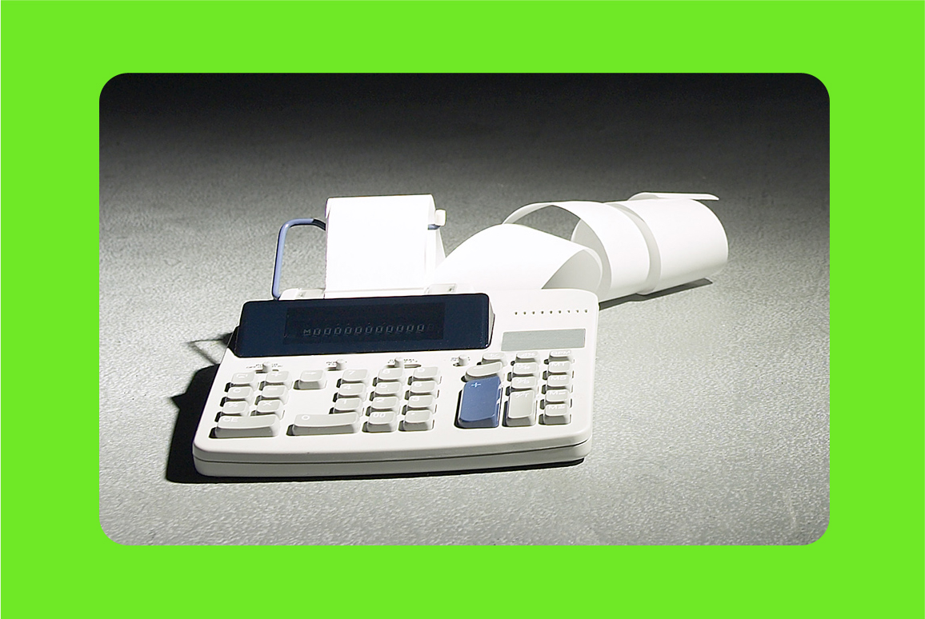
Part I
Business Valuation Fundamentals

Slide 5
“October. This is one of the dangerous months to speculate in stocks. The others are July, January, September, April, November, May, March, June, December, August & February.”
Mark Twain

Slide 6

What is a Business Valuation?
Process of gathering financial, economic
and industry data to establish a dollar value of an interest in a business through quantitative and qualitative analysis

Slide 7
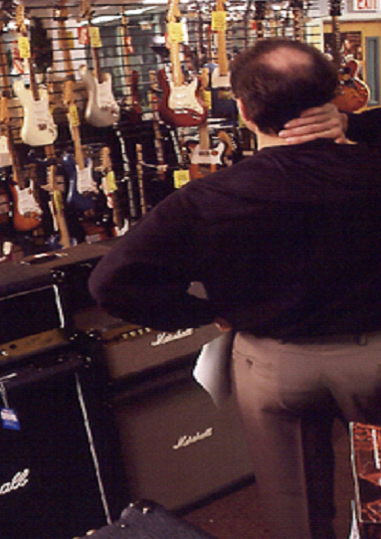
What is a Business Valuation?
The process of establishing the value of both tangible assets (such as store fixtures, office equipment, rental instrument pools) and intangible assets (customer lists, vendor product lines, trademarks, goodwill) assets.

Slide 8

What is a Business Valuation?
An estimation
of the dollar value of a given business ownership interest
at a specific point in time.

Slide 9

Why Perform a Valuation?
Tax Purposes, to accompany estate and gift tax returns
Succession planning to transfer wealth

Slide 10

Why Perform a Valuation?
Purchase, sale or merger
Buy / sell agreements between business partners

Slide 11

Why Perform a Valuation?
Litigation support
  Divorce
  Disruption of business due to theft, fire, flood
  Shareholder disputes

Slide 12

Why Perform a Valuation?
Management assistance
Bank financing
Seek investors
Employee benefit & Stock
Ownership Plans (ESOP)
Business plans
Bankruptcy & reorganization

Slide 13
Course Title
What is Value?

Slide 14

Value? It depends….
I want to sell the business and retire?
My partner wants out?
My employees want in?
My bank wants assurance?
My spouse wants to divorce me?
I drop dead?

Slide 15
What is Value?
Fair Market Value
“The price at which the property would change hands between a willing buyer and a willing seller, when the buyer is not under any compulsion to buy, and the seller is not under any compulsion to sell, and both parties have reasonable knowledge of the relevant facts.” (Revenue Ruling 59-60)

Slide 16
What is Value?
Liquidation Value
Investment / Strategic Value
Book Value
Going Concern Value
Fair Value

Slide 17
Value Drivers
An Investor’s Motivations, such as the desire to…
Buy a job, or be involved in something rewarding
Realize a desired rate of return on investment
Achieve a greater market position, access new product lines
Business Characteristics, such as the business’s…
Size and location
Customer base and loyalty; competitive position
Years in business and quality of management
Financial condition and stability of earnings

Slide 18

CAUTION !!
Different value drivers dictate the use of different valuation approaches, making business valuation a “highly subjective” process

Slide 19
Valuation Approaches
Three Common Approaches to Valuation:
“Income” approach
“Market” approach
“Asset” approach

Slide 20

Valuation Approaches
The “Income” Approach
Value is based on the company’s future income producing capacity

Slide 21

Valuation Approaches
The “Market” Approach
Value is based on
the selling price of comparable companies
in the same market or industry

Slide 22

Valuation Approaches
The “Asset” Approach
Value is based on the assets (both tangible and intangible) of a business, less its liabilities

Slide 23
Valuation Approaches
Each approach contains generally accepted valuation methods unique to that approach; some of the common valuation methods are…

Slide 24
Common Methods
Adjusted
Net
Assets
Discounted
Future
Earnings
Excess Earnings
Return on Assets
Capitalization
of
Earnings
Commonly
Used
Methods
Dividend
Paying
Capacity
Price
Earnings
Ratio
Rule
Of Thumb
Industry
Formulas

Slide 25
Problems, Challenges, Quirks
Finding the right data
Interpreting the data
Properly adjusting the data
No comparable market data
Lots of risk, little reward
Stiff competition
Lagging technologies

Slide 26

Part II
How Do I Add Value To My
Music Store —And Get Paid For It?

Slide 27
These “DON’T” Add Value
Increasing sales at the expense of G.P. $$$
Increasing a profitable activity at the expense of cash flow (i.e. funding a rental program with cash or excessive debt)
A large build-up of inventory
Multiple talents of a single owner
Using a “unique” accounting system
Keeping things technologically the same
Carrying numerous product lines in an effort to be all things to all customers

Slide 28

These “DO” Add Value
A company that’s profitable by design
A company that has positive cash flow
A company that isn’t over-inventoried
A company that has a profitable rental program
A company that has a loyal, diverse customer base
A company that has a solid management team able to operate without total reliance on the owner
A company using a supportable accounting system
A company that can document & prove their earnings

Slide 29

What Buyers Look For
Great locations and demographics
  Potential for growth
  Expanding into a new market
Proven history of earnings
Existing instrument rental programs
Access to new school markets
Strong management team
Reliable accounting records and systems

Slide 30
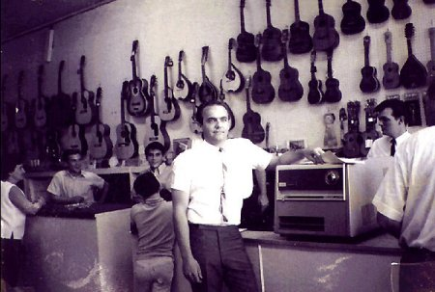
Part III
“How Much Can I Get For My Store?”

Slide 31
How much buyers will pay…
They start with net income, convert it to net cash flow, and pay a multiple of that cash flow
They pay 3 – 6 times cash flow, with on average between 4 to 5 times
That multiple can vary greatly by buyer
A store that yields $200,000 of annual cash flow could yield a $1,000,000 selling price
But, that’s for the assets only…the owners then have to pay off all their debts and related taxes!!
Most buyers will NOT pay for any cash flow benefits they enjoy from the acquisition of your store

Slide 32
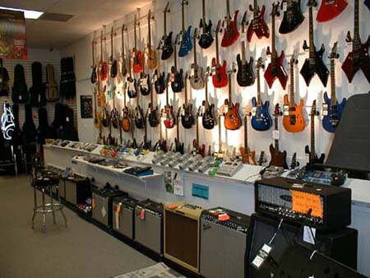
Time to Try it…..
“Let’s calculate the value of a hypothetical music store…”

Slide 33
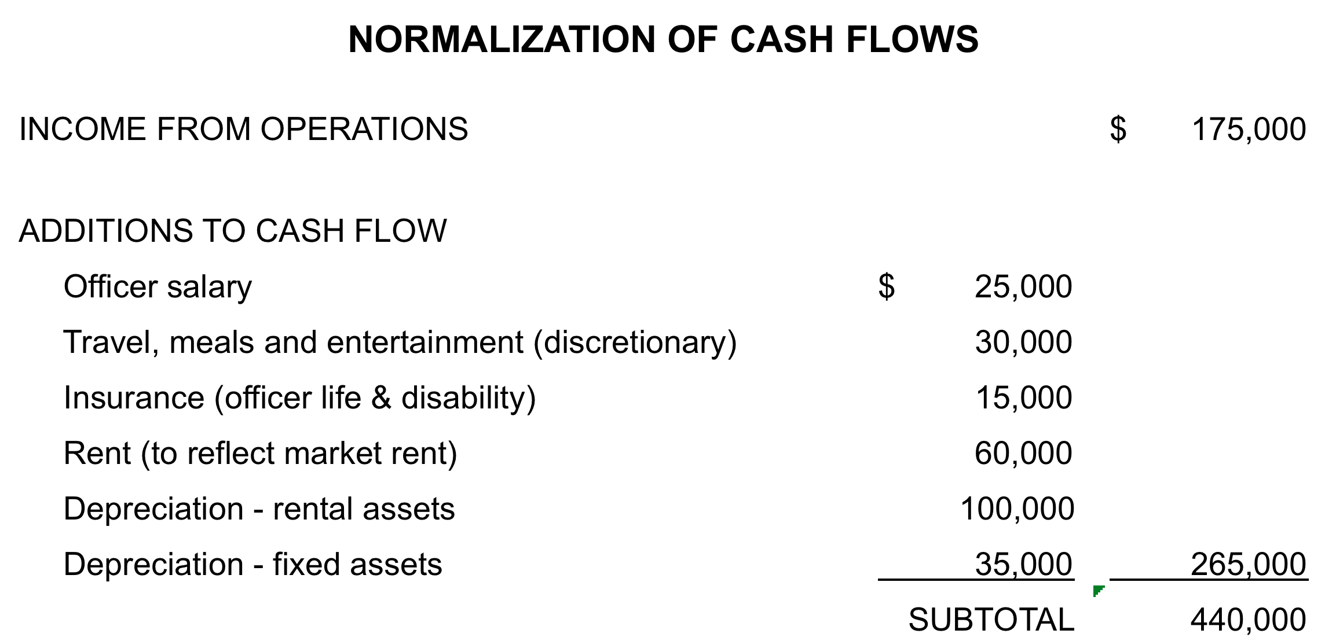
Cash Flow

Slide 34
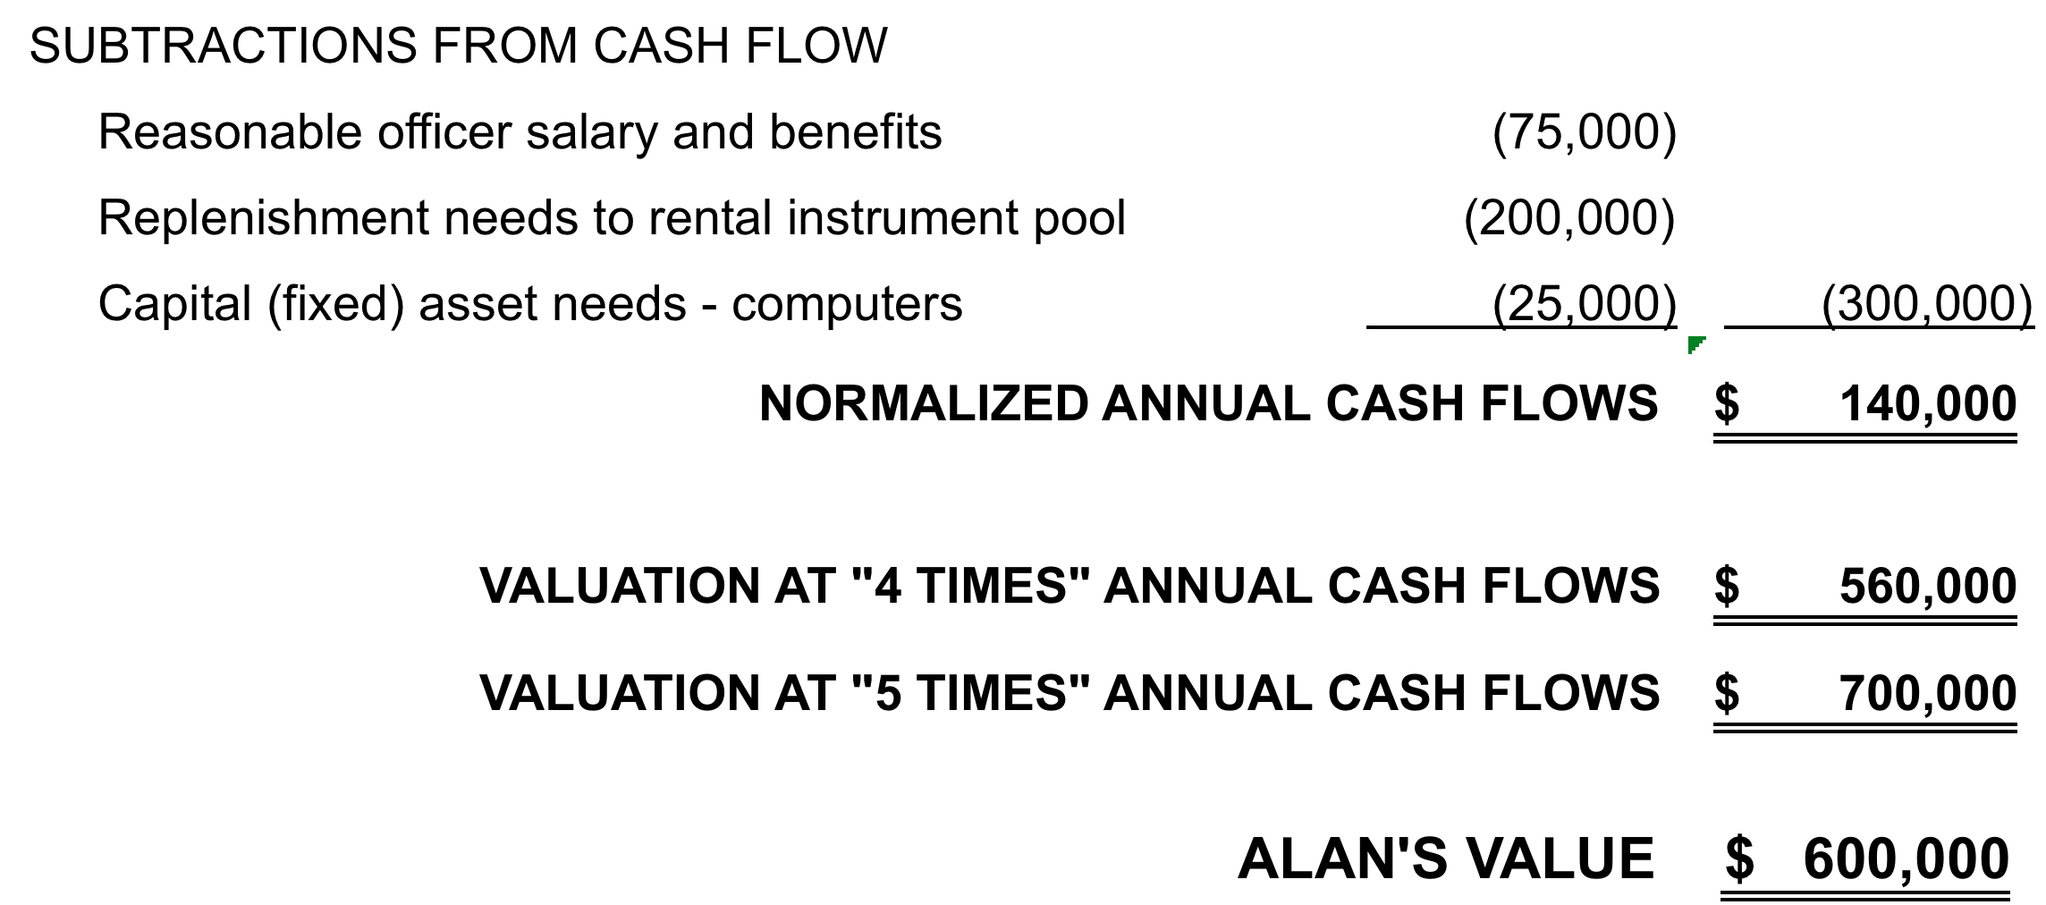
Cash Flow

Slide 35
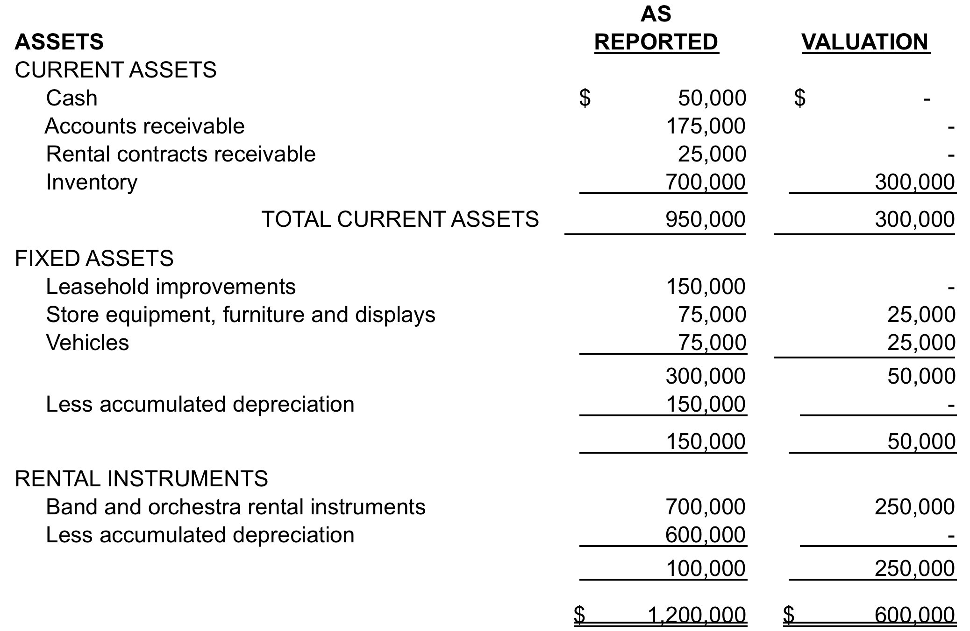
Asset Approach

Slide 36
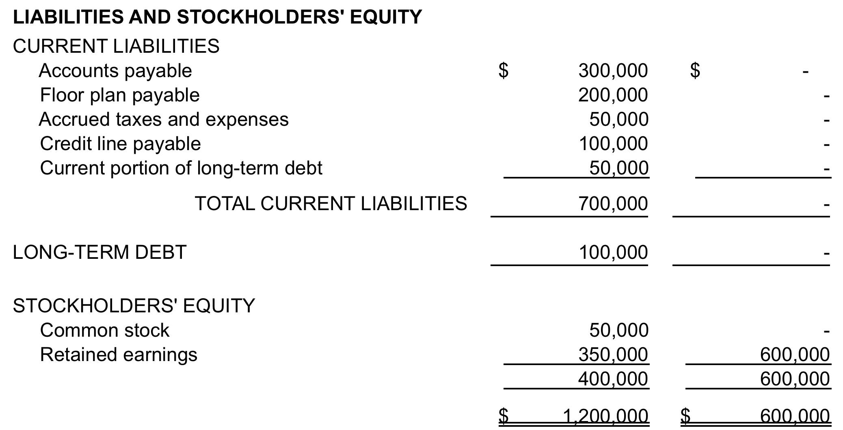
Asset Approach

Slide 37
Part IV
Some final Succession Planning
Tips & Strategies

Slide 38
Exit Options
Be honest about why you want to get out…
  Tired?
  Illness, too much risk, or your heart’s not in it anymore?
Consider all options…
  Transfer (sell or gift) ownership to your kids
  Sell to key employee(s)
  Sell to a national or regional buyer
  Sell to a local music retailer
  Orderly liquidation
  Employee Stock Option Plan (ESOP)?

Slide 39
Strategies & Tips
Plan early and don’t deny your own mortality
Avoid the “King Solomon” pitfall
Consider outside management for young heirs
Address technical issues, don’t over-promise & revisit as things change
When selling, consider timing
Document profitability and stability
Determine a value and find the right buyer

Slide 40

Need more help?
Contact Jen Lowe after this seminar
to set up a meeting time

Slide 41

Thanks RPMDA! Any questions?
Any Questions?

