Slide 1


Poor Cash Flow Is NOT The Problem!
presented by
Daniel Jobe Joel Menchey
Friedman, Kannenberg & Co., PC Menchey Music Service

Slide 2


Grow your
business like
you grow your
bank account…

Slide 3

Objectives
Discuss the difference between “good” and “bad” cash flow
Determine when debt seem appropriate
Offer 5 focused areas for improvement
Q&A along the way

Slide 4

What is cash flow?
A revenue or expense stream that changes a cash account over a given period. Cash inflows usually arise from one of three activities - financing, operations or investing - although this also occurs as a result of donations or gifts in the case of personal finance. Cash outflows result from expenses or investments. This holds true for both business and personal finance.

Slide 5

What cash flow really is!
“The movement of money in and out of a business”

Slide 6

How to create “good” cash flow
Increase revenues
Control expenses
Sell-off aged inventory and old other assets

Slide 7

Why do I have “bad” cash flow?
Discounting fast turning inventory
Supporting a personal life style
Other reasons?

Slide 8
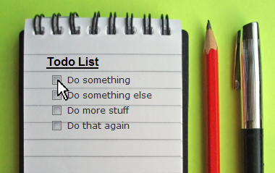
Items for your “TO-DO” list…

Slide 9

Action Step 1
Develop internal financial controls and review your financials monthly;
If you’re not profitable... get profitable!!

Slide 10

Action Step 2
Refine your inventory control and decrease your aging inventory….
you are NOT running a museum!

Slide 11

Action Step 3
Banking – Create a relationship with a bank…even when you do not need them.

Slide 12
Is borrowing right for me?
“Let us not bankrupt our todays by paying interest on the regrets of yesterday and by borrowing in advance the troubles of tomorrow.”
Ralph Sockman

Slide 13

Action Step 4
Obtain the “type” of financing based on asset life.

Slide 14
Which financing is right for me?
Vendor Credit – inventory purchases
Bank Line of Credit – help with the slow times of year
Long Term Notes – long term assets that return money over time (i.e. rental assets, vehicles, computers)

Slide 15
When should I not borrow?
To extend the term of a note longer than the asset value, or return on the asset (i.e. vehicles, rental pools)
To fund the losses of an unprofitable part of your business
To support your personal lifestyle

Slide 16

Action Step 5
Before you try something new….
  Write a plan
  Figure out how to track it
  Know when to push forward …or “get out”

Slide 17

Create a Plan…
“It takes as much energy to wish as it does to plan.”
Eleanor Roosevelt

Slide 18

Tracking…and pushing forward
Monthly Profit & Loss Statement
Balance Sheet
Annual “P&L” Budget
Marketing Plan
Business Plan

Slide 19


Slide 20

Need more help?
Contact Jen Lowe after this seminar
to set up a meeting time

